Slide 1
Mathematical Economics
Lecture 12

Slide 2

Plan
Differentiable functions from $ℝ^{n}$ to $ℝ^{m}$
Jacobian matrix and partial derivatives
Chain Rule
Mean Value theorem

Slide 3
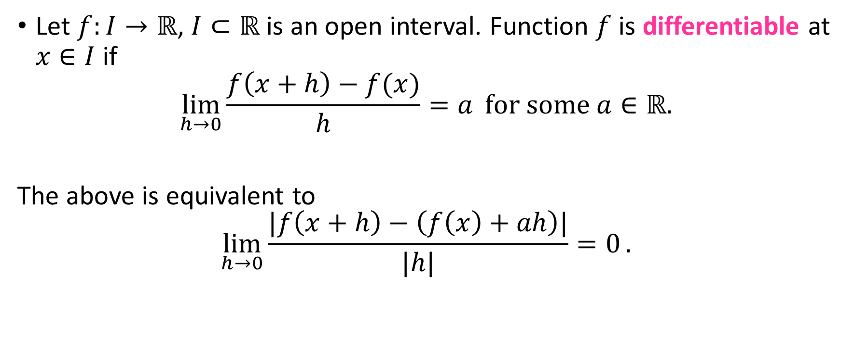

Differentiability, $ℝ→ℝ$
Let $f:I→ℝ$, $I⊂ℝ$ is an open interval. Function $f$ is differentiable at $x∈I$ if
$$\lim_{h→0}{\frac{f\left(x+h\right)−f(x)}{h}=a} for some a∈ℝ.$$
The above is equivalent to
$$\lim_{h→0}{\frac{|f\left(x+h\right)−\left(f\left(x\right)+ah\right)|}{|h|}=0}.$$

Slide 4
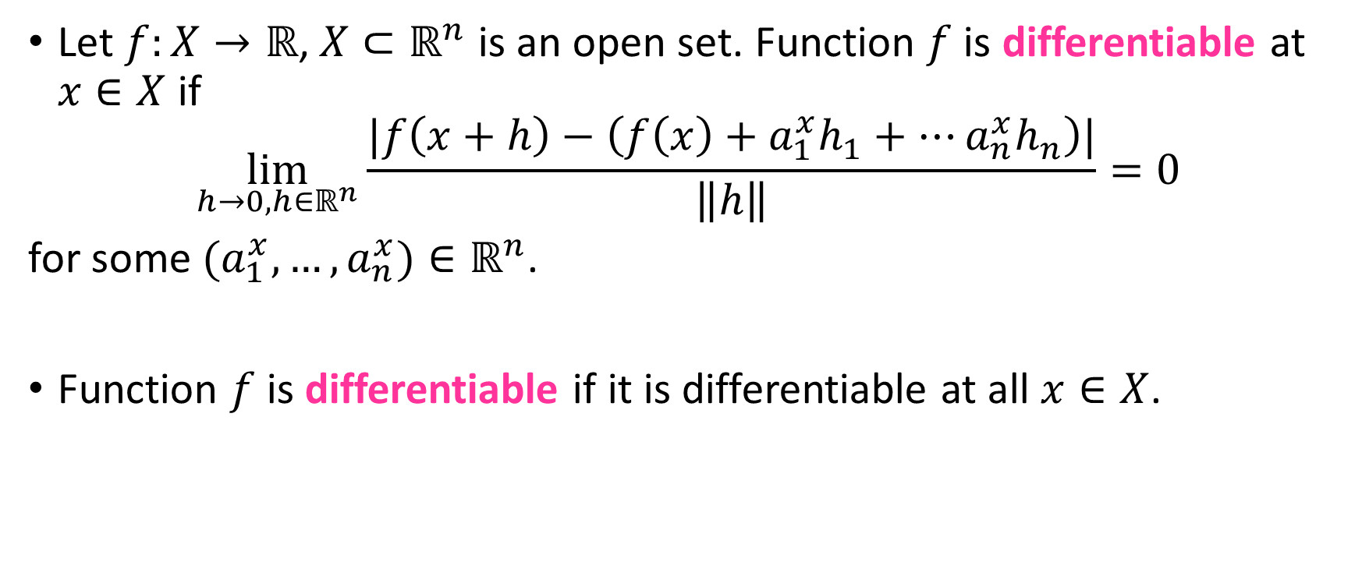

Differentiability, $ℝ^{n}→ℝ$
Let $f:X→ℝ$,$X⊂ℝ^{n}$ is an open set. Function $f$ is differentiable at $x∈X$ if
$$\lim_{h→0,h∈ℝ^{n}}{\frac{|f\left(x+h\right)−\left(f\left(x\right)+a_{1}^{x}h_{1}+…a_{n}^{x}h_{n}\right)|}{\left\|h\right\|}=0}$$
for some $(a_{1}^{x},…,a_{n}^{x})∈ℝ^{n}$.
Function $f$ is differentiable if it is differentiable at all $x∈X$.

Slide 5
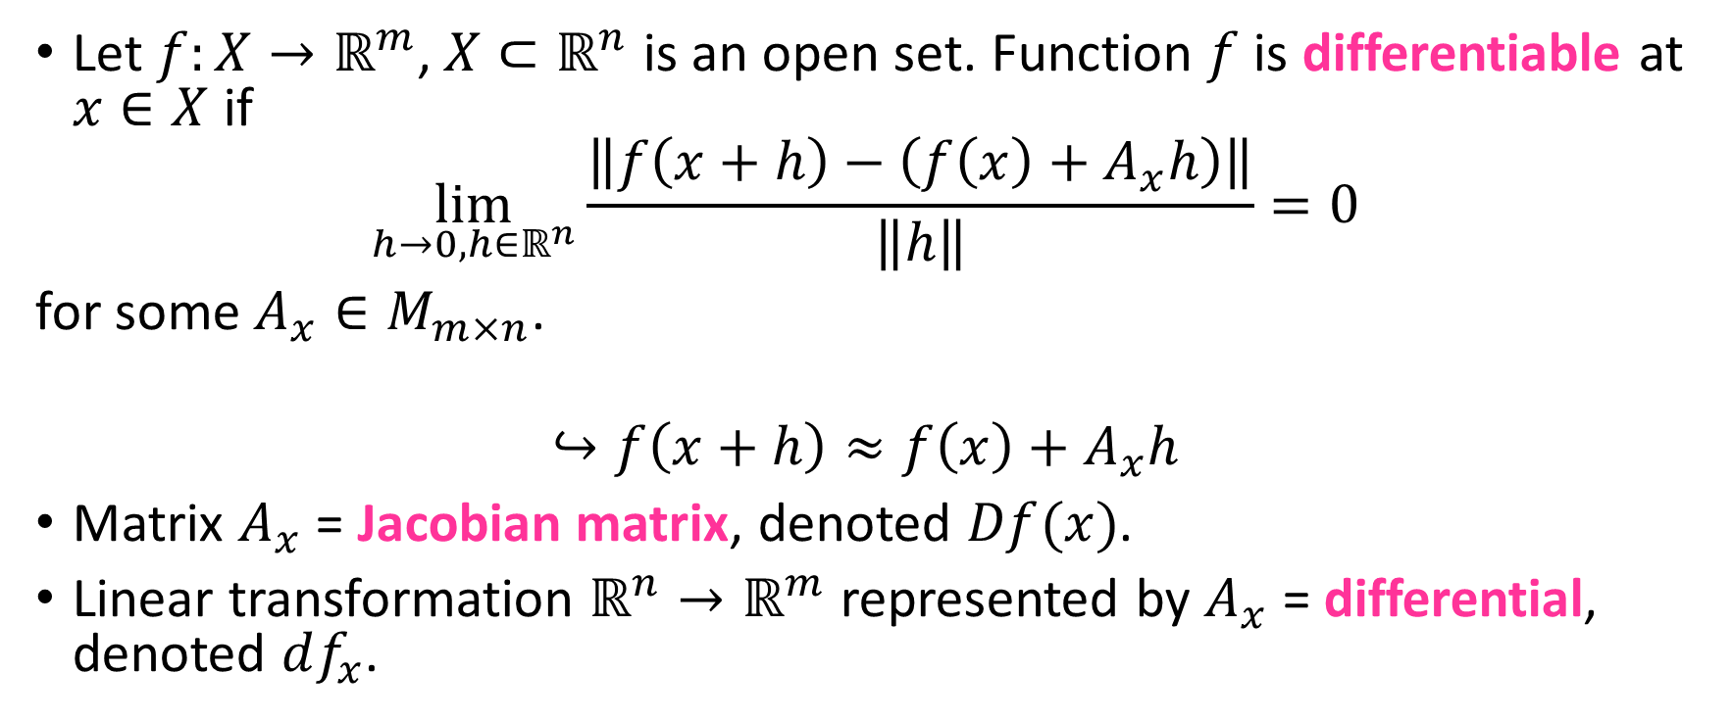

Differentiability, $ℝ^{n}→ℝ^{m}$
Let $f:X→ℝ^{m}$,$X⊂ℝ^{n}$ is an open set. Function $f$ is differentiable at $x∈X$ if
$$\lim_{h→0,h∈ℝ^{n}}{\frac{\left\|f\left(x+h\right)−\left(f\left(x\right)+A_{x}h\right)\right\|}{\left\|h\right\|}=0}$$
for some $A_{x}∈M_{m×n}$.
$$↪f\left(x+h\right)≈f\left(x\right)+A_{x}h$$
Matrix $A_{x}$ = Jacobian matrix, denoted $Df(x)$.
Linear transformation $ℝ^{n}→ℝ^{m}$ represented by $A_{x}$ = differential, denoted $df_{x}$.

Slide 6
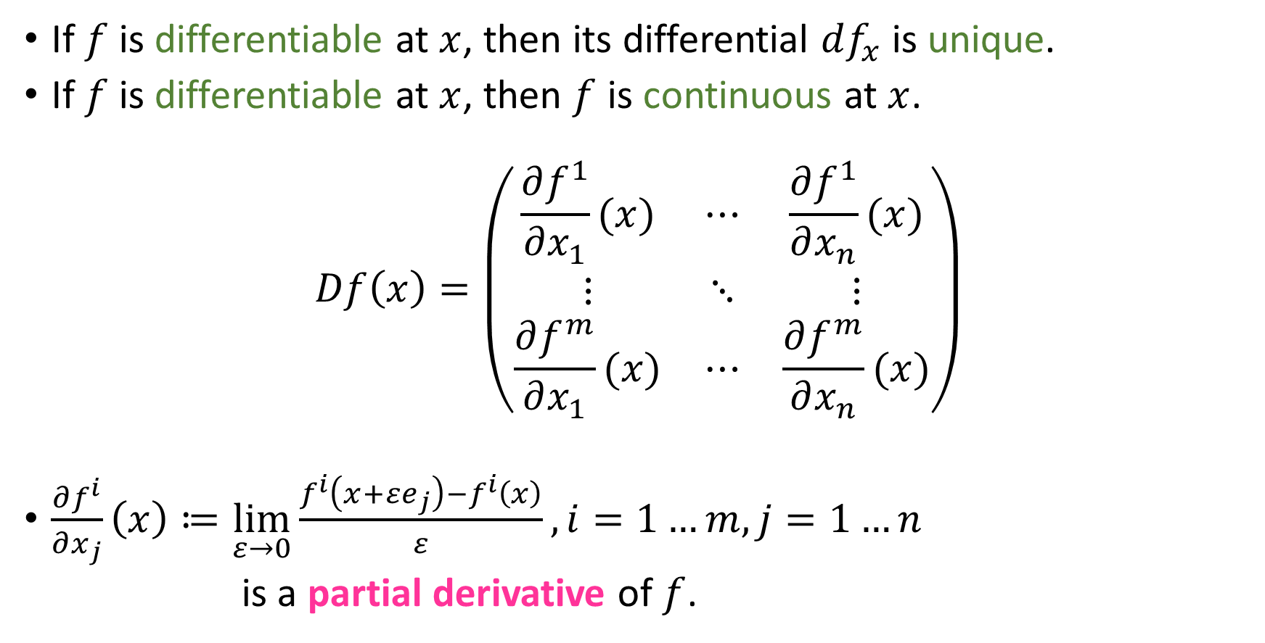
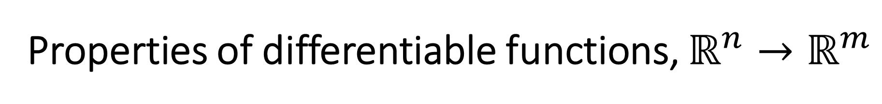
Properties of differentiable functions, $ℝ^{n}→ℝ^{m}$
If $f$ is differentiable at $x$, then its differential $df_{x}$ is unique.
If $f$ is differentiable at $x$, then $f$ is continuous at $x$.
$$Df\left(x\right)=\left(\begin{matrix}\frac{∂f^{1}}{∂x_{1}}(x) & ⋯ & \frac{∂f^{1}}{∂x_{n}}(x) \\ ⋮ & ⋱ & ⋮ \\ \frac{∂f^{m}}{∂x_{1}}(x) & ⋯ & \frac{∂f^{m}}{∂x_{n}}(x)\end{matrix}\right)$$
$\frac{∂f^{i}}{∂x_{j}}\left(x\right)≔\lim_{ε→0}{\frac{f^{i}\left(x+εe_{j}\right)−f^{i}\left(x\right)}{ε}},i=1…m, j=1…n$
is a partial derivative of $f$.

Slide 7
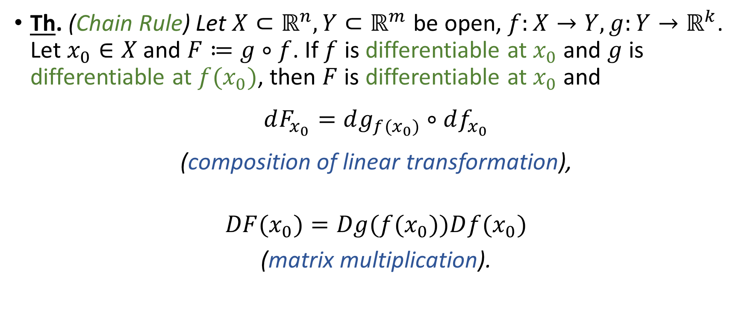
Chain Rule
Th. (Chain Rule) Let $X⊂ℝ^{n}, Y⊂ℝ^{m}$ be open, $f:X→Y, g:Y→ℝ^{k}$. Let $x_{0}∈X$ and $F≔g∘f$. If $f$ is differentiable at $x_{0}$ and $g$ is differentiable at ${f(x}_{0})$, then $F$ is differentiable at $x_{0}$ and
$$dF_{x_{0}}=dg_{f(x_{0})}∘df_{x_{0}}$$
(composition of linear transformation),
$$DF{(x}_{0})=Dg({f(x}_{0}))D{f(x}_{0})$$
(matrix multiplication).

Slide 8
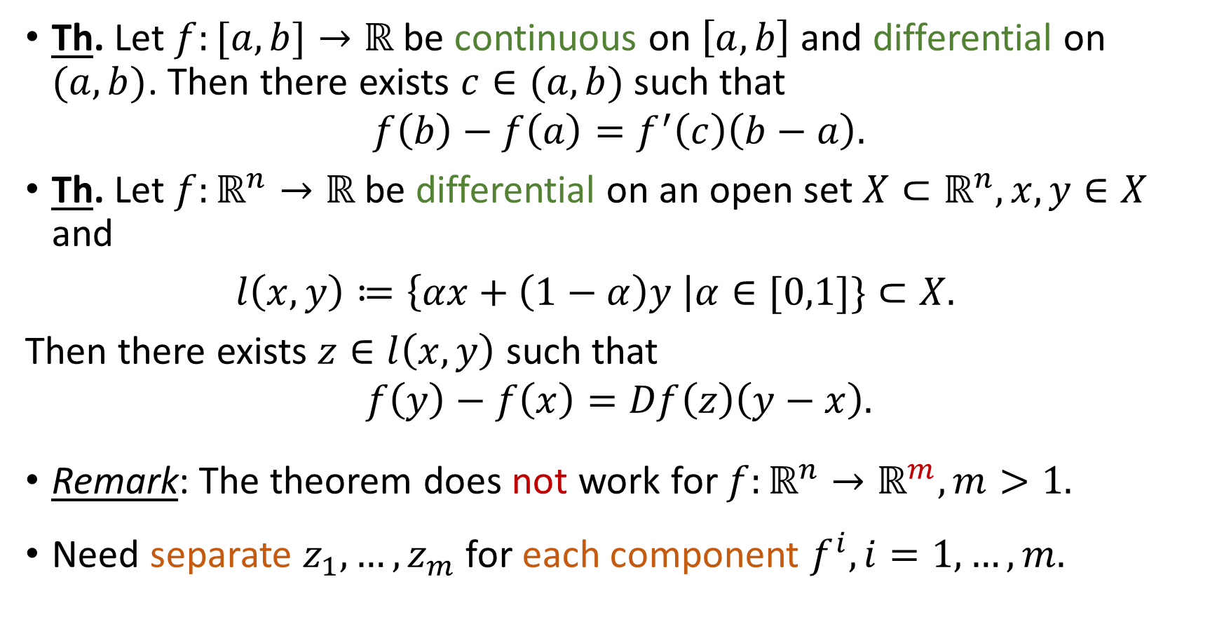
Mean Value Theorem
Th. Let $f:[a,b]→ℝ$ be continuous on $\left[a,b\right]$ and differential on $(a,b)$. Then there exists $c∈(a,b)$ such that
$$f\left(b\right)−f\left(a\right)=f^{′}\left(c\right)\left(b−a\right).$$
Th. Let $f:ℝ^{n}→ℝ$ be differential on an open set $X⊂ℝ^{n}, x,y∈X$ and
$l\left(x,y\right)≔\left\{αx+\left(1−α\right)y \right|α∈[0,1]\}⊂X.$
Then there exists $z∈l\left(x,y\right)$ such that
$$f\left(y\right)−f\left(x\right)=Df\left(z\right)\left(y−x\right).$$
Remark: The theorem does not work for $f:ℝ^{n}→ℝ^{m}, m>1.$
Need separate $z_{1},…,z_{m}$ for each component $f^{i}, i=1,…,m.$

Slide 9
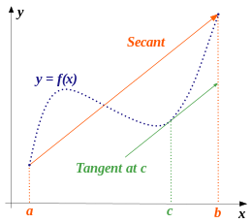
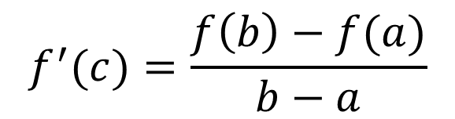
Mean Value Theorem: Illustration
$$f^{′}(c)=\frac{f\left(b\right)−f(a)}{b−a}$$

Slide 10
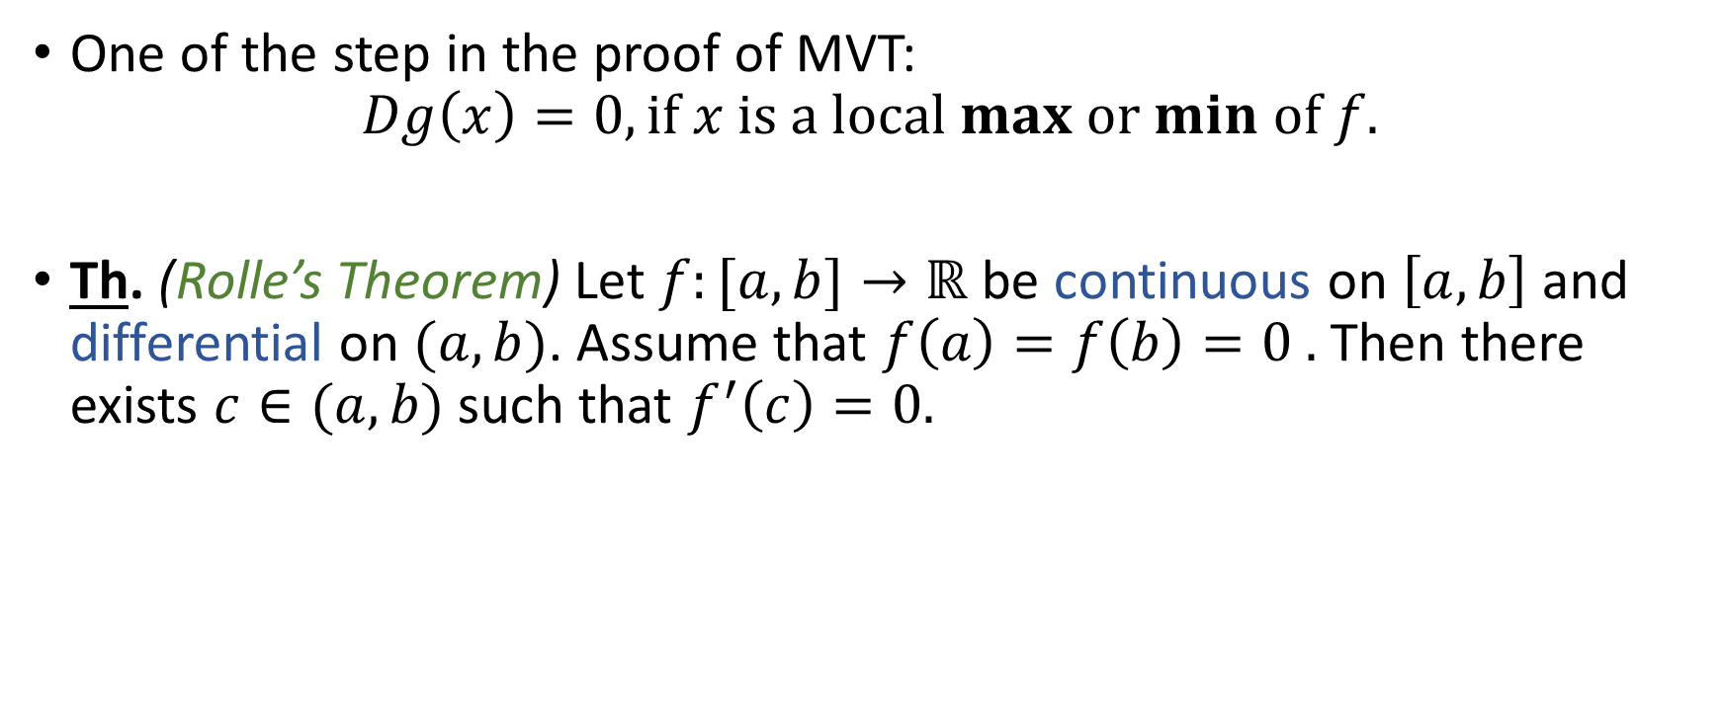
Mean Value Theorem: Corollary
One of the step in the proof of MVT:
$$Dg\left(x\right)=0, if x is a local max or min of f.$$
Th. (Rolle’s Theorem) Let $f:[a,b]→ℝ$ be continuous on $\left[a,b\right]$ and differential on $(a,b)$. Assume that $f\left(a\right)=f\left(b\right)=0 .$ Then there exists $c∈(a,b)$ such that $f^{′}\left(c\right)=0.$

